Slide 1
What Happened to Digital Procurement Transformation?
2023/12/22

Slide 2
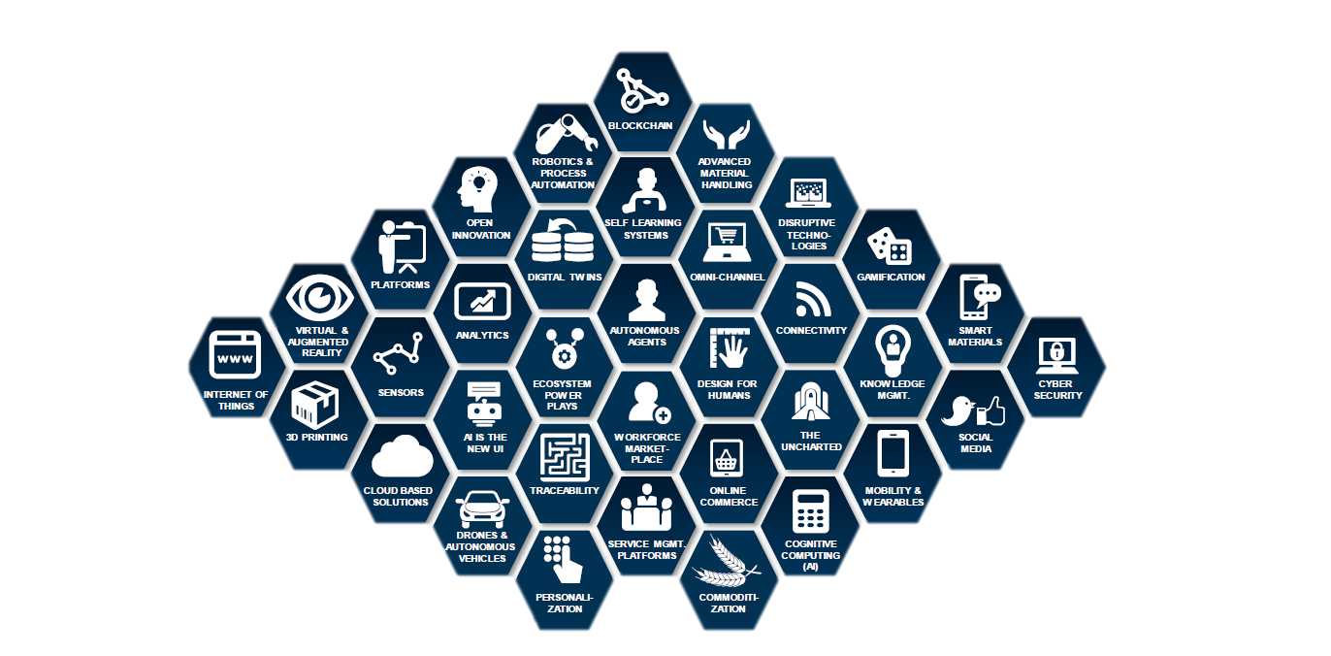
Digital Themes

Slide 3
Digital Themes for Procurement
Simple & repeatable tasks (P2P process)
Estimated 20-50% of FTEs can be replaced
Should Cost analytics
Cloud Computing
VR for supplier visit/audit
RPA
Other Tech
AI
Block Chain
Complex Tasks that require some level of pattern recognition
Categorize spend, contract and supplier data to draw actionable insights
More reliable & transparent process, thus reduce delivery & payment time
Data security (eg: contract mgmt)
Big Data Analytics
Internet of Things
More data driven decision making
Better cost break down based on spend insights
Increased traceability of products across SC
Better inventory mgmt.

Slide 4
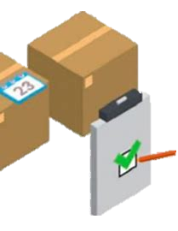
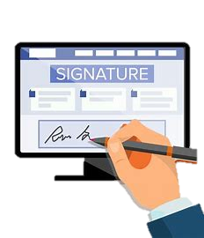
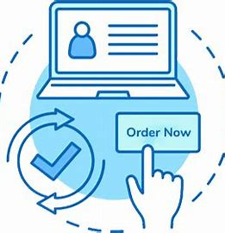
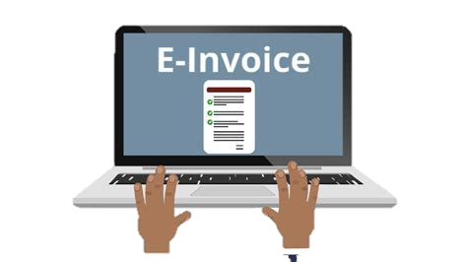
Digitalization applied on Procurement value chain
Conduct Negotiation
Award Contract
Goods Receipt/Storage/Distribution
RFI/RFP/RFQ
Raise PR
Place PO
Make Payment
MRP/ERP – inventory module
E-Tender
Digital Contract & eSignature
I-CATLOG
Vendor Portal/ Digital Invoicing
MRP
E-Auction

Slide 5
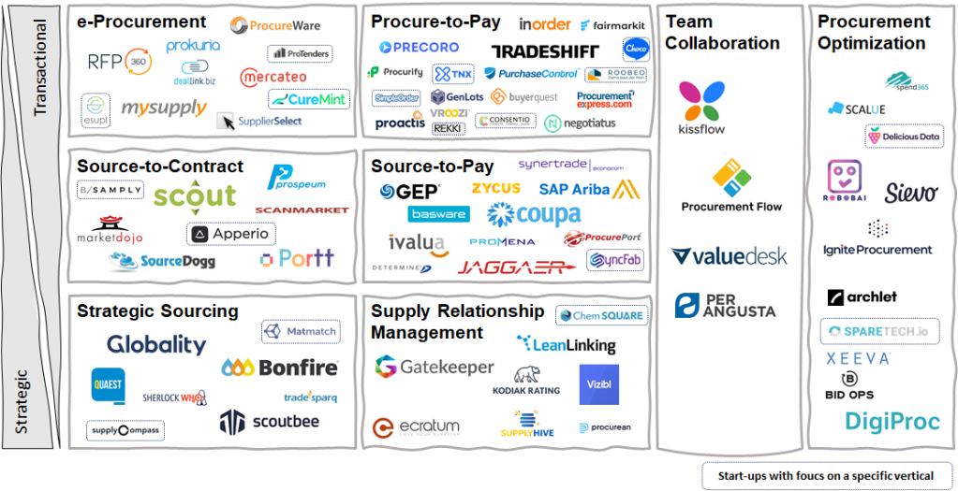
Digital Procurement Ecosystem – Multiple players & solutions
Resource: https://www.kodiakhub.com/blog/the-hitchhikers-guide-to-digital-procurement

Slide 6
Digital Value Realized
15%
I
Innovation
25%
C
Cost
35%
S
Productivity
40%
Saving
Q
50%
Employee Satisfaction
A
75%
Regulatory
R
Notes:
The market is flooded with offerings, but a major gap exists between the targeted value and the value realized

Slide 7
Path to Digital Transformation
Digital Transformation
Digitalization
Digitization
Enablement across people, process & technology
Multi process optimization across cost & revenue center
Business processes & tools enabling incremental value creation from digitized data
Eg: RPA, AI, cognitive reporting
Converting paper based info to digital formats
Eg: Paper contracts to e-contracts, tender to e-tender
Notes:
数码化，数字化，数字化转型

Slide 8
WHY benefits from digital are slow to deliver
Process & Policy
Data
Procurement thinking that old school controls are relevant and needed in Digital tools
Legacy control requirements take away from “self-service benefits”
Data quality: rubbish in is still rubbish out
Some of this rubbish data is now 25 years old
WHY
Most try to keep same op model after implementing digital
Remain mired in historic philosophies
Lack of end-to-end ownership and siloes between upstream and downstream
Different workforce now than before
Skills have not evolved together with technology
Adoption of digital solutions requires agile workforce
People
Operating Model

Slide 9
HOW to solve the problem
Process & Policy
Data
Leverage technology solutions to replace old school controls
Configure the tool end to end on your process, phase 2 never happens
Data quality: rubbish in is still rubbish out
Some of this rubbish data is now 25 years old
HOW
Digital COE skills needed
Front Office: Communication & Relationship mgmt, Project mgmt skill
Middle office: data scientist & Analytics, digital solutions
Back office: lean and chat bot skills
Source to Pay is one process, it needs one owner
The organization must change together with system landscape
People
Operating Model

Slide 10
Thank You

